Slide 1
MTH 166 Lecture-30
Line Integral

Slide 2
Unit 6: Vector Calculus-II
(Book: Advanced Engineering Mathematics by Jain and Iyengar,Chapter-15)
Topic:
Vector Integral Calculus
Learning Outcomes:
1. To calculate Line integral w.r.t to an arc length
2. To calculate Line integral of a vector field (Work Done)

Slide 3
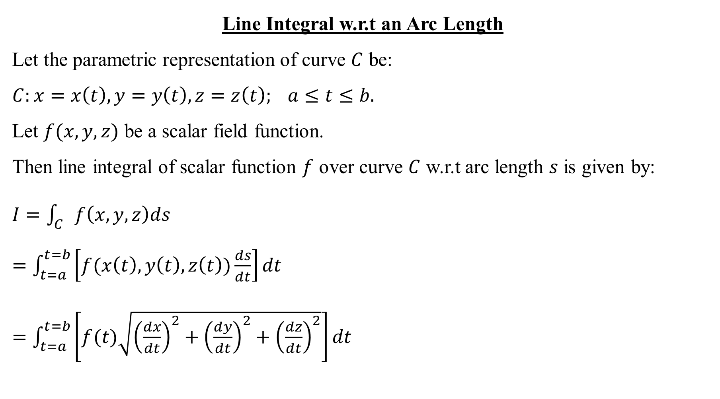
Line Integral w.r.t an Arc Length
Let the parametric representation of curve $C$ be:
$C:x=x\left(t\right), y=y\left(t\right), z=z\left(t\right); a≤t≤b.$
Let $f(x,y,z)$ be a scalar field function.
Then line integral of scalar function $f$ over curve $C$ w.r.t arc length $s$ is given by:
$I=\int_{C}{f\left(x,y,z\right)ds}$
$=\int_{t=a}^{t=b}{\left[f(x\left(t\right),y\left(t\right),z\left(t\right))\frac{ds}{dt}\right]dt}$
$=\int_{t=a}^{t=b}{\left[f(t)\sqrt{{\left(\frac{dx}{dt}\right)}^{2}+{\left(\frac{dy}{dt}\right)}^{2}+{\left(\frac{dz}{dt}\right)}^{2}}\right]dt}$

Slide 4
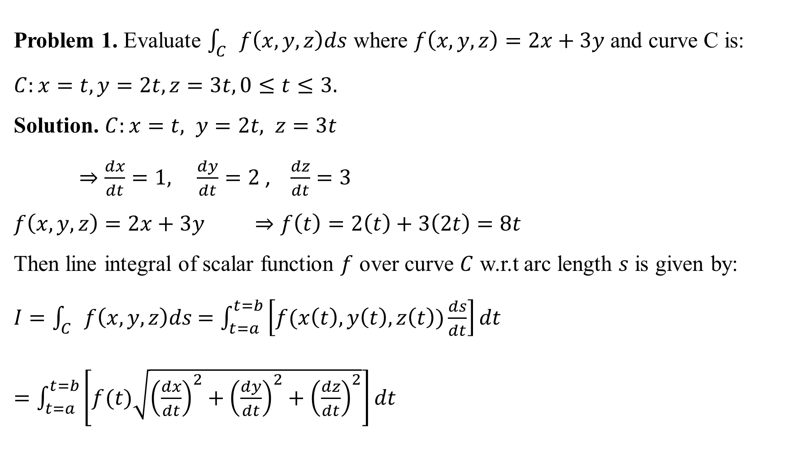
Problem 1. Evaluate $\int_{C}{f\left(x,y,z\right)ds}$ where $f\left(x,y,z\right)=2x+3y$ and curve C is:
$C:x=t, y=2t, z=3t, 0≤t≤3.$
Solution. $C:x=t, y=2t, z=3t$
$⇒\frac{dx}{dt}=1, \frac{dy}{dt}=2$ , $\frac{dz}{dt}=3$
$f\left(x,y,z\right)=2x+3y ⇒f\left(t\right)=2\left(t\right)+3\left(2t\right)=8t$
Then line integral of scalar function $f$ over curve $C$ w.r.t arc length $s$ is given by:
$I=\int_{C}{f\left(x,y,z\right)ds}$ $=\int_{t=a}^{t=b}{\left[f(x\left(t\right),y\left(t\right),z\left(t\right))\frac{ds}{dt}\right]dt}$
$=\int_{t=a}^{t=b}{\left[f(t)\sqrt{{\left(\frac{dx}{dt}\right)}^{2}+{\left(\frac{dy}{dt}\right)}^{2}+{\left(\frac{dz}{dt}\right)}^{2}}\right]dt}$

Slide 5

$I=\int_{t=0}^{t=3}{\left[8t\sqrt{{\left(1\right)}^{2}+{\left(2\right)}^{2}+{\left(3\right)}^{2}}\right]dt}$
$=8\sqrt{14}\int_{t=0}^{t=3}{tdt}$
$=8\sqrt{14}{\left[\frac{t^{2}}{2}\right]}_{0}^{3}$
$=8\sqrt{14}\left[\frac{9}{2}−0\right]$
$=36\sqrt{14}$ Answer.

Slide 6
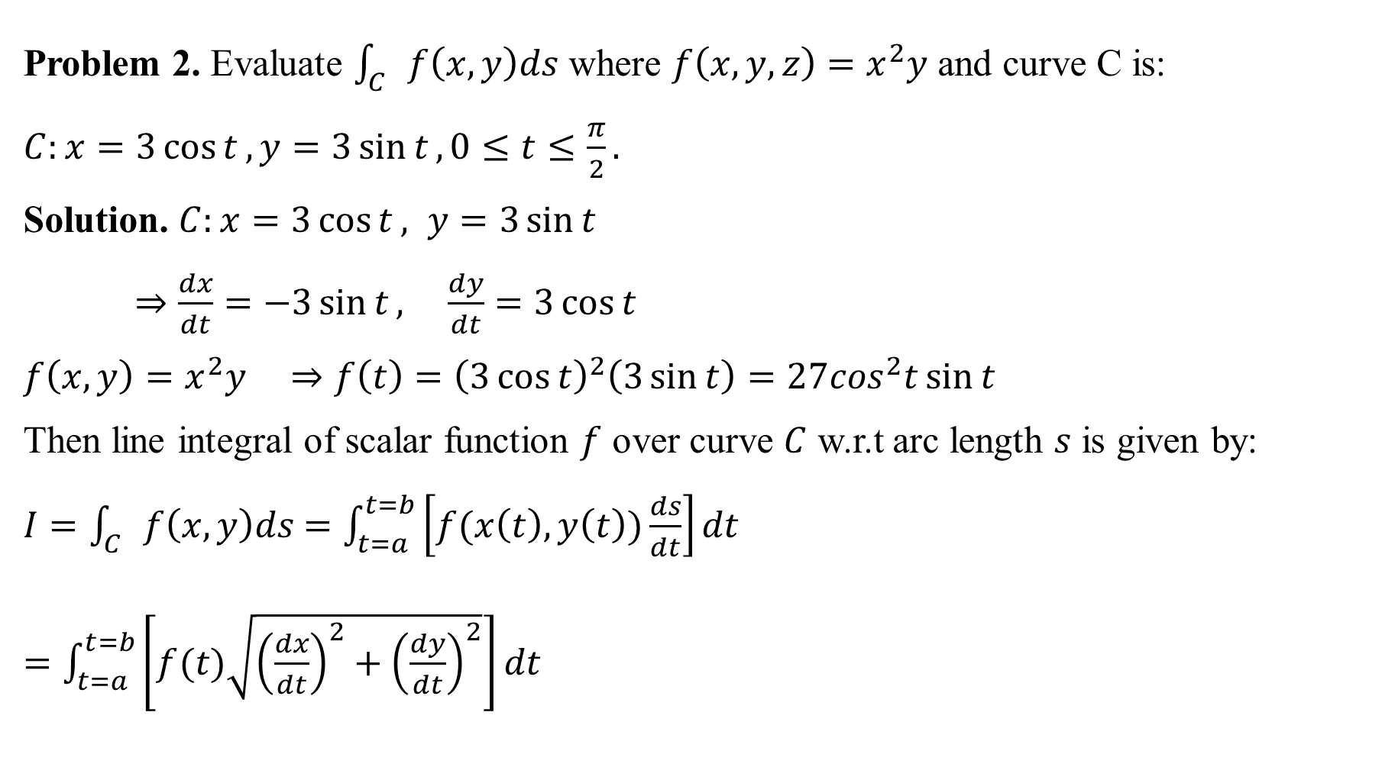
Problem 2. Evaluate $\int_{C}{f\left(x,y\right)ds}$ where $f\left(x,y,z\right)=x^{2}y$ and curve C is:
$C:x=3\cos{t}, y=3\sin{t}, 0≤t≤\frac{π}{2}.$
Solution. $C:x=3\cos{t}, y=3\sin{t}$
$⇒\frac{dx}{dt}=−3\sin{t}, \frac{dy}{dt}=3\cos{t}$
$f\left(x,y\right)=x^{2}y ⇒f\left(t\right)={\left(3\cos{t}\right)}^{2}\left(3\sin{t}\right)=27\cos^{2}t\sin{t}$
Then line integral of scalar function $f$ over curve $C$ w.r.t arc length $s$ is given by:
$I=\int_{C}{f\left(x,y\right)ds}$ $=\int_{t=a}^{t=b}{\left[f(x\left(t\right),y\left(t\right))\frac{ds}{dt}\right]dt}$
$=\int_{t=a}^{t=b}{\left[f(t)\sqrt{{\left(\frac{dx}{dt}\right)}^{2}+{\left(\frac{dy}{dt}\right)}^{2}}\right]dt}$

Slide 7

$I=\int_{t=0}^{t=\frac{π}{2}}{27\cos^{2}t\sin{t}\left[\sqrt{{\left(−3\sin{t}\right)}^{2}+{\left(3\cos{t}\right)}^{2}}\right]dt}$
$=27×3\int_{t=0}^{t=\frac{π}{2}}{\cos^{2}t\sin{t}dt}$
$=−81\int_{t=0}^{t=\frac{π}{2}}{\cos^{2}t(−sin{t)}dt}$
$=−81{\left[\frac{{\left(\cos{t}\right)}^{3}}{3}\right]}_{0}^{\frac{π}{2}}$
$=−27\left[{\left(\cos{\frac{π}{2}}\right)}^{3}−{\left(\cos{0}\right)}^{3}\right]$
$=−27\left(0−1\right)=27$ Answer.

Slide 8
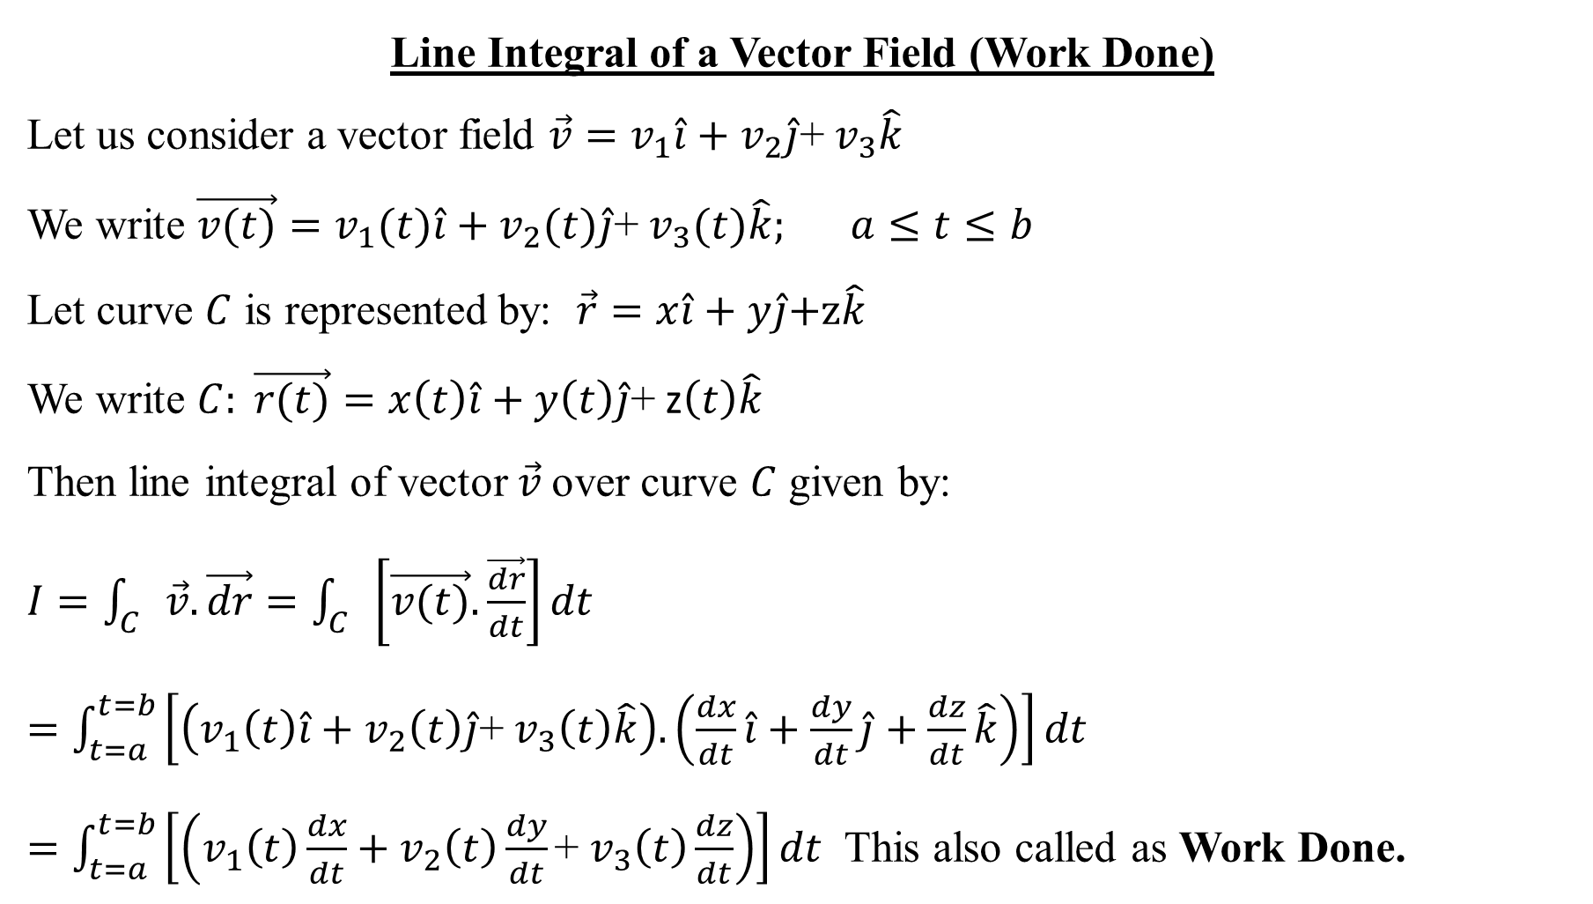
Line Integral of a Vector Field (Work Done)
Let us consider a vector field $\vec{v}=v_{1}\hat{i}+v_{2}\hat{j}$+ $v_{3}\hat{k}$
We write $\vec{v(t)}=v_{1}(t)\hat{i}+v_{2}(t)\hat{j}$+ $v_{3}(t)\hat{k}; a≤t≤b$
Let curve $C$ is represented by: $\vec{r}=x\hat{i}+y\hat{j}\text{+}\text{z}\hat{k}$
We write $C: \vec{r(t)}=x\left(t\right)\hat{i}+y\left(t\right)\hat{j}$+ z$\left(t\right)\hat{k}$
Then line integral of vector $\vec{v}$over curve $C$ given by:
$I=\int_{C}{\vec{v}.\vec{dr}}=\int_{C}{\left[\vec{v(t)}.\frac{\vec{dr}}{dt}\right]dt}$
$=\int_{t=a}^{t=b}{\left[\left(v_{1}\left(t\right)\hat{i}+v_{2}\left(t\right)\hat{j}\text{+} v_{3}\left(t\right)\hat{k}\right). \left(\frac{dx}{dt}\hat{i}+\frac{dy}{dt}\hat{j}+\frac{dz}{dt}\hat{k}\right)\right]dt}$
$=\int_{t=a}^{t=b}{\left[\left(v_{1}\left(t\right)\frac{dx}{dt}+v_{2}\left(t\right)\frac{dy}{dt}\text{+} v_{3}\left(t\right)\frac{dz}{dt}\right)\right]dt}$ This also called as Work Done.

Slide 9
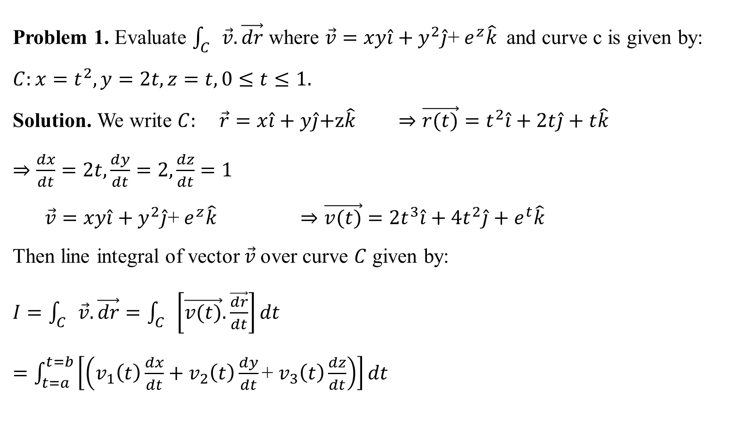
Problem 1. Evaluate $\int_{C}{\vec{v}.\vec{dr}}$ where $\vec{v}=xy\hat{i}+y^{2}\hat{j}$+ $e^{z}\hat{k}$ and curve c is given by:
$C:x=t^{2}, y=2t, z=t,0≤t≤1.$
Solution. We write $C:$ $\vec{r}=x\hat{i}+y\hat{j}\text{+}\text{z}\hat{k} ⇒\vec{r(t)}=t^{2}\hat{i}+2t\hat{j}+t\hat{k}$
$⇒\frac{dx}{dt}=2t, \frac{dy}{dt}=2,\frac{dz}{dt}=1$
$\vec{v}=xy\hat{i}+y^{2}\hat{j}$+ $e^{z}\hat{k} ⇒\vec{v(t)}=2t^{3}\hat{i}+4t^{2}\hat{j}+e^{t}\hat{k}$
Then line integral of vector $\vec{v}$over curve $C$ given by:
$I=\int_{C}{\vec{v}.\vec{dr}}=\int_{C}{\left[\vec{v(t)}.\frac{\vec{dr}}{dt}\right]dt}$
$=\int_{t=a}^{t=b}{\left[\left(v_{1}\left(t\right)\frac{dx}{dt}+v_{2}\left(t\right)\frac{dy}{dt}\text{+} v_{3}\left(t\right)\frac{dz}{dt}\right)\right]dt}$

Slide 10

$I=\int_{t=a}^{t=b}{\left[\left(v_{1}\left(t\right)\frac{dx}{dt}+v_{2}\left(t\right)\frac{dy}{dt}\text{+ }v_{3}\left(t\right)\frac{dz}{dt}\right)\right]dt}$
$=\int_{t=0}^{t=1}{\left[\left(\left(2t^{3}\right)\left(2t\right)+\left(4t^{2}\right)\text{(2)}\text{+} \left(e^{t}\right)(1)\right)\right]dt}$
$=\int_{t=0}^{t=1}{\left[4t^{4}+8t^{2}+e^{t}\right]dt}$
$={\left[\frac{4}{5}t^{5}+\frac{8}{3}t^{3}+e^{t}\right]}_{t=0}^{t=1}$
$=\left[\frac{4}{5}+\frac{8}{3}+e\right]−\left[0+0+1\right]$
$=\frac{37}{15}+e$ Answer.

Slide 11
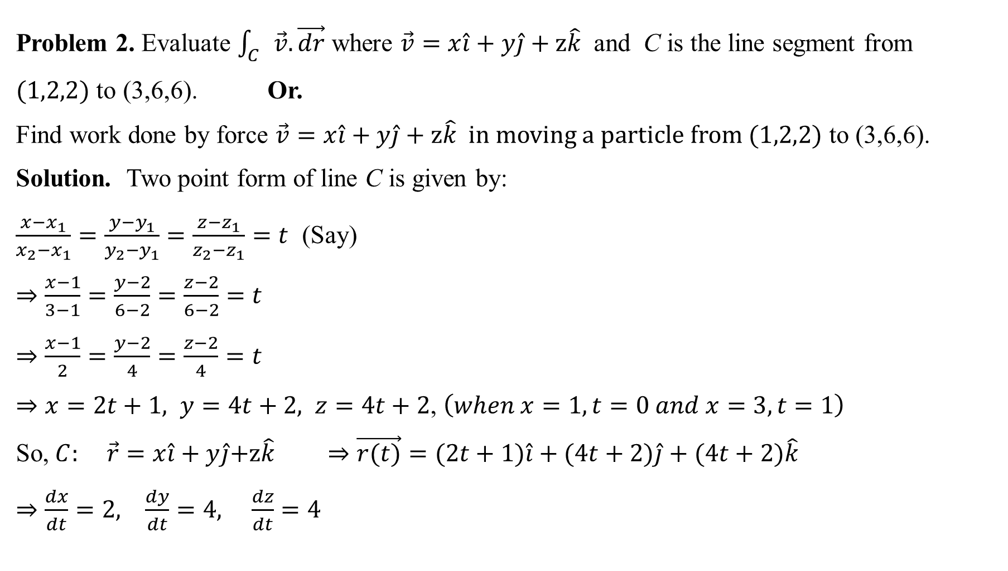
Problem 2. Evaluate $\int_{C}{\vec{v}.\vec{dr}}$ where $\vec{v}=x\hat{i}+y\hat{j}+z\hat{k}$ and C is the line segment from
$(1,2,2)$ to (3,6,6). Or.
Find work done by force $\vec{v}=x\hat{i}+y\hat{j}+z\hat{k}$ in moving a particle from $(1,2,2)$ to (3,6,6).
Solution. Two point form of line C is given by:
$\frac{x−x_{1}}{x_{2}−x_{1}}=\frac{y−y_{1}}{y_{2}−y_{1}}=\frac{z−z_{1}}{z_{2}−z_{1}}=t$ (Say)
$⇒\frac{x−1}{3−1}=\frac{y−2}{6−2}=\frac{z−2}{6−2}=t$
$⇒\frac{x−1}{2}=\frac{y−2}{4}=\frac{z−2}{4}=t$
$⇒x=2t+1, y=4t+2, z=4t+2$, $\left(when x=1, t=0 and x=3, t=1\right)$
So, $C:$ $\vec{r}=x\hat{i}+y\hat{j}\text{+}\text{z}\hat{k} ⇒\vec{r(t)}=(2t+1)\hat{i}+(4t+2)\hat{j}+(4t+2)\hat{k}$
$⇒\frac{dx}{dt}=2, \frac{dy}{dt}=4, \frac{dz}{dt}=4$

Slide 12
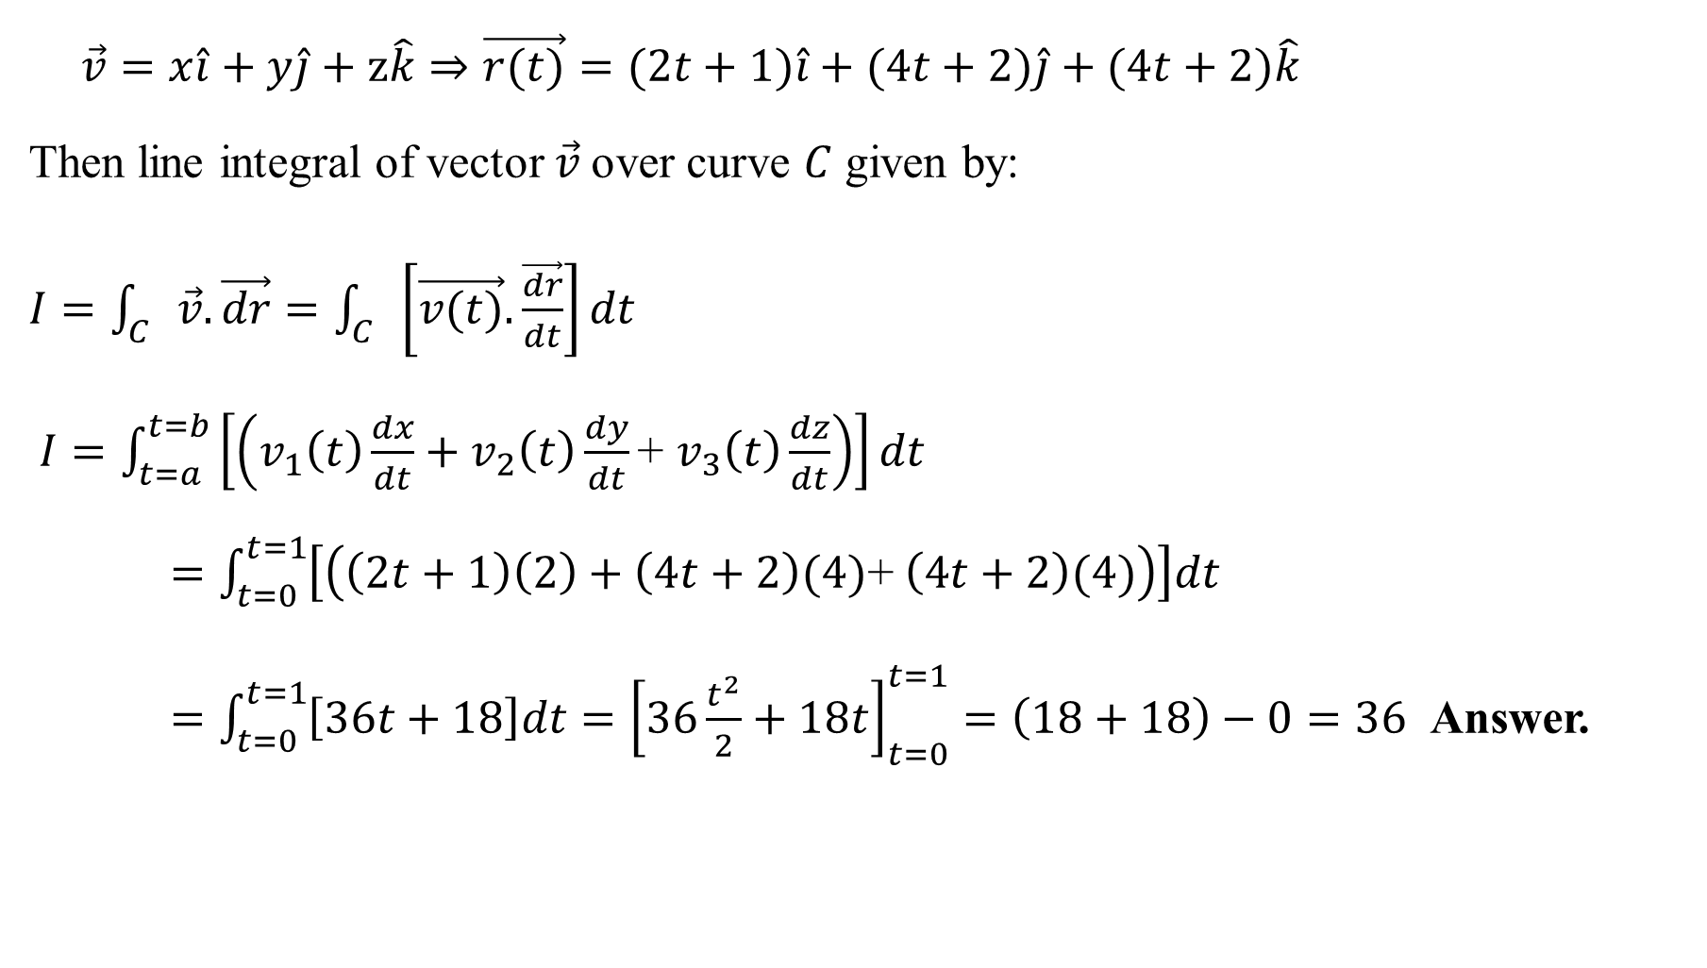
$$\vec{v}=x\hat{i}+y\hat{j}+z\hat{k}⇒\vec{r(t)}=(2t+1)\hat{i}+(4t+2)\hat{j}+(4t+2)\hat{k}$$
Then line integral of vector $\vec{v}$over curve $C$ given by:
$I=\int_{C}{\vec{v}.\vec{dr}}=\int_{C}{\left[\vec{v(t)}.\frac{\vec{dr}}{dt}\right]dt}$
$I=\int_{t=a}^{t=b}{\left[\left(v_{1}\left(t\right)\frac{dx}{dt}+v_{2}\left(t\right)\frac{dy}{dt}\text{+ }v_{3}\left(t\right)\frac{dz}{dt}\right)\right]dt}$
$=\int_{t=0}^{t=1}{\left[\left(\left(2t+1\right)\left(2\right)+\left(4t+2\right)\text{(4)}\text{+} \left(4t+2\right)(4)\right)\right]dt}$
$=\int_{t=0}^{t=1}{\left[36t+18\right]dt}={\left[36\frac{t^{2}}{2}+18t\right]}_{t=0}^{t=1}=\left(18+18\right)−0=36$ Answer.

Slide 13

This Photo by Unknown Author is licensed under CC BY-NC-ND

